Slide 1
EEP
Lec 4
Dr. Michael Nasief

Slide 2
Series AC Resonance Circuits

Slide 3
Introduction
When the voltage V applied to an electrical network containing resistance, inductance and capacitance is in phase with the resulting current I, the circuit is said to be resonant. The phenomenon of resonance is of great value in all branches of radio, television and communications Engineering,

Slide 4
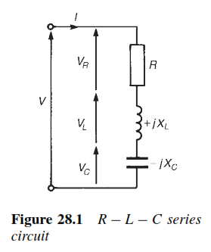
Series resonance

Slide 5
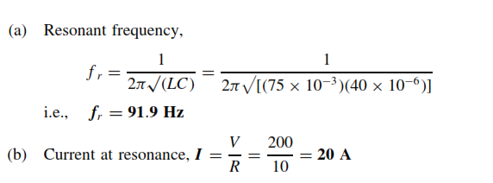

Slide 6
Quality factor - Q Factor
Q-factor is an abbreviation for quality factor and refers to the ‘goodness’ of a reactive component.

Slide 7
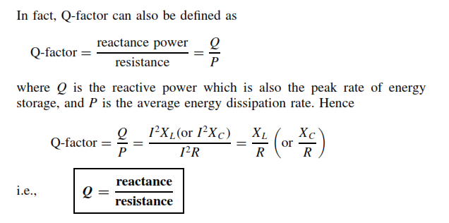
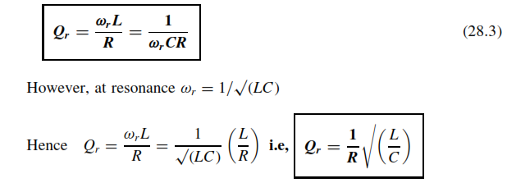

Slide 8
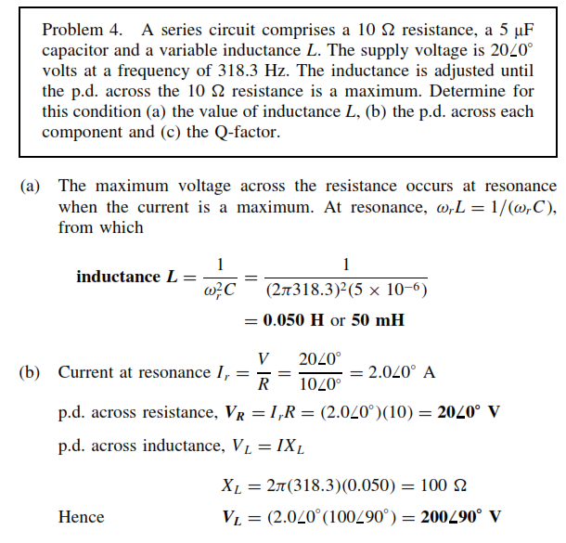

Slide 9
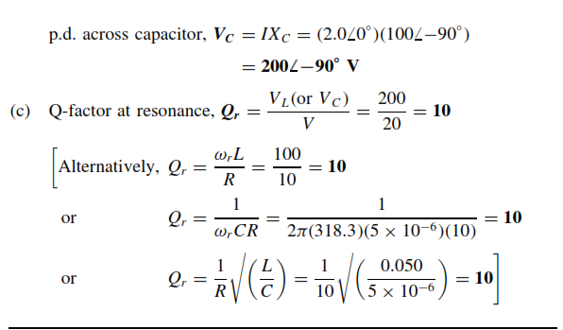

Slide 10
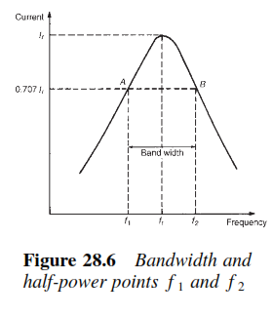
Bandwidth

Slide 11
Bandwidth

Slide 12
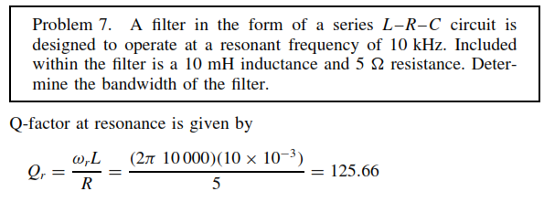

Slide 13
Parallel resonance

Slide 15
Dynamic Resistance

Slide 16
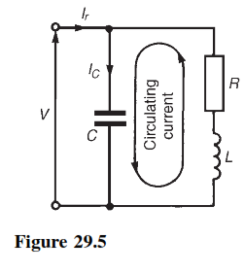
Q-factor in a parallel network

